Slide 1
CMIS 3142 - Computational Methods
T. Arudchelvam
Department of CMIS,
Faculty of Applied Sciences,
Wayamba University of Sri Lanka

Slide 2
Time
Monday 8.30 a.m.
Thursday 3.30 p.m.

Slide 3
References
Jennings, A., Matrix computation for engineers and scientists, John Willey, London, 1977.
E. Kreyszig, Advanced Engineering Mathematics, John Willey & Sons, Inc., Singapore, 1999.
Hoole, S.R.H., Computer Aided Analysis and Design of Electromagnetic Devices, Elsevier, New York, 1989.

Slide 4
Evaluations
Continuous Assessments 30%
  Assignments
  Spot exams
  Mid exams
Semester-End Theory Examination 70%

Slide 5
Areas to be covered
Data Representation and Computational Error:
  Floating-point numbers, rounding rules, machine precision, floating-point arithmetic; well-posed problems, problems vs. algorithms, data error vs. computational error, forward error vs. backward error, conditioning of a problem, stability of an algorithm.
System of Linear Equations:
  Programming aspects for different types of matrices such as full matrix, symmetric matrix, sparse matrix, symmetric sparse matrix, row vector, column vector.
  Program Design for matrices and other relevant Operations, SOR (Successive over relaxation Method), Cholesky Method, ICCG (Incomplete Choleski Conjugate Gradient method).
  Program design for different problems using matrices
Fixed point iteration, Jacobian Matrix, Finite Difference Method

Slide 6
Aims
To gain knowledge on numerical methods for Computational science and program design to solve real world problems using numerical methods.

Slide 7
Intended Learning Outcomes
On successful completion of this course module, students should be able to:
  Interpret/illustrate data representation and computational errors,
  Identify basics and methods to solve systems of linear equations,
  Solve given real world problems using numerical methods
    Analyze different ways of solving problems using numerical methods
    Compile/arrange all possible alternative solutions
    Program design from each solution
    compare all the alternative solutions and recommend the best solution

Slide 8
Floating point Numbers

Slide 9
Floating point numbers
Binary representation of fractional numbers
IEEE 754 standard

Slide 10
Binary ➔ Decimal conversion
23.47 = 2×10¹ + 3×10⁰ + 4×10⁻¹ + 7×10⁻²
decimal point
10.01_{two} = 1×2¹ + 0×2⁰ + 0×2⁻¹ + 1×2⁻²
binary point
= 1×2 + 0×1 + 0×½ + 1×¼
= 2 + 0.25 = 2.25

Slide 11
Decimal ➔ Binary conversion
Write number as sum of powers of 2
0.8125 = 0.5 + 0.25 + 0.0625
= 2⁻¹ + 2⁻² + 2⁻⁴
= 0.1101_{two}
Algorithm: Repeatedly multiply fraction by two until fraction becomes zero.
0.8125 ➔ 1.625
0.625 ➔ 1.25
0.25 ➔ 0.5
0.5 ➔ 1.0

Slide 12
Beware
Finite decimal digits ➔ finite binary digits
Example:
  0.1_{ten} ➔ 0.2 ➔ 0.4 ➔ 0.8 ➔ 1.6 ➔ 1.2 ➔ 0.4 ➔ 0.8 ➔ 1.6 ➔ 1.2 ➔ 0.4 …
  0.1_{ten} = 0.00011001100110011…_{two}
  = 0.00011_{two} (infinite repeating binary)
  The more bits, the binary rep gets closer to 0.1_{ten}

Slide 13
Assignment 01
Write a Java program to convert a given decimal number to binary number
Write a Java program to convert a given binary number to decimal point number
Do the same (1 and 2) for converting decimal to Octal and Hexa decimal
Submit on or before:

Slide 14
Scientific notation
Decimal:
-123,000,000,000,000 ➔ -1.23 × 10¹⁴
0.000 000 000 000 000 123 ➔ +1.23× 10⁻¹⁶
Binary:
110 1100 0000 0000 ➔ 1.1011× 2¹⁴
-0.0000 0000 0000 0001 1011 ➔ -1.1101 × 2⁻¹⁶

Slide 15
Floating point representation
Three pieces:
  sign
  exponent
  mantissa
Format:
  Fixed-size representation (32-bit, 64-bit)
  1 sign bit
  more exponent bits ➔ greater range
  more mantissa bits ➔ greater accuracy
sign
exponent
mantissa

Slide 16
IEEE 754 floating point standards
Single precision (32-bit) format
Bits-->
Normalized rule: number represented is
(-1)^{S}×1.F×2^{E-127,} E (≠ 00…0 or 11…1)
Example: +101101.101➔+1.01101101×2⁵
1
8
23
S
E
F
0
1000 0100
0110 1101 0000 0000 0000 000
Notes:
Actual exponent = 5 = E – 127
E = 5 + 127 = 132
Convert 132₁₀ to binary => 10000100

Slide 17
To provide for negative exponents, we will use a biased exponent.
A bias is a number that is approximately midway in the range of values expressible by the exponent. We subtract the bias from the value in the exponent to determine its true value.

Slide 18
Features of IEEE 754 format
Sign: 1➔negative, 0➔non-negative
mantissa:
  Normalized number: always a 1 left of binary point
  (except when E is 0 or 255)
  Do not waste a bit on this 1 ➔ "hidden 1"
Exponent:
  Not two's-complement representation
  Unsigned interpretation minus bias

Slide 19
Example: 0.75
0.75 _{ten} = 0.11 _{two} = 1.1 x 2 ⁻¹
1.1 = 1. F → F = 1
E – 127 = -1 → E = 127 -1 = 126 = 01111110_{two}
S = 0
00111111010000000000000000000000 = 0x3F400000

Slide 20
Example 0.1_{ten} - Check float.a
0.1_{ten} = 0.00011_{two}
= 1.10011_{two} x 2 ⁻⁴ = 1.F x 2 ^{E-127}
F = 10011 -4 = E – 127
E = 127 -4 = 123 = 01111011_{two}
00111101110011001100110011001100110011
0x3DCCCCCD, why D at the least significant digit?

Slide 21
Assignment 2
Write a Java program to convert a given decimal number into the IEEE 754 Single precision format and vice versa.
Submit on or before –

Slide 23
IEEE Double precision standard
E not 00…0 (decimal 0) or 11…1(decimal 2047)
Normalized rule: number represented is
(-1)^{S}×1.F×2^{E-1023}
1
11
52
S
E
F

Slide 24
Special-case numbers
Problem:
  hidden 1 prevents representation of 0
Solution:
  make exceptions to the rule
Bit patterns reserved for unusual numbers:
  E = 00…0
  E = 11…1

Slide 25
Special-case numbers
Zeroes:
➔ +0
➔ -0
Infinities:
➔ +∞
➔ -∞
0
00…0
00…0
1
00…0
00…0
0
11…1
00…0
1
11…1
00…0

Slide 26
Denormalized numbers
No hidden 1
Allows numbers very close to 0
E = 00…0 ➔ Different interpretation applies
Denormalization rule: number represented is
  (-1)^{S}×0.F×2⁻¹²⁶ (single-precision)
  (-1)^{S}×0.F×2⁻¹⁰²² (double-precision)
Note: zeroes follow this rule
Not a Number (NaN): E = 11…1; F != 00…0

Slide 27
IEEE 754 summary
E = 00…0, F = 00…0 ➔ 0
E = 00…0, F ≠ 00…0 ➔ denormalized
00…00 < E < 11…1 ➔ normalized
E = 11…1
  F = 00…0 ➔ infinities
  F ≠ 00…0 ➔ NaN

Slide 28
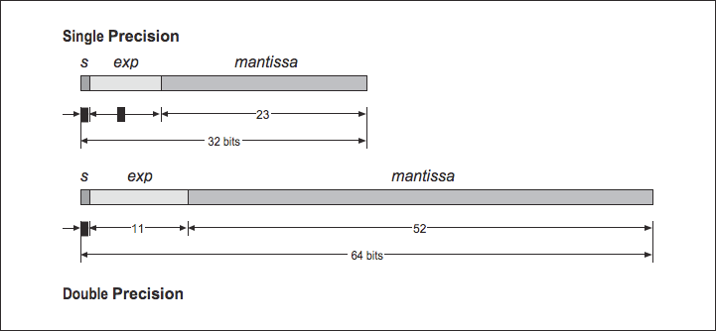
Summary

Slide 29
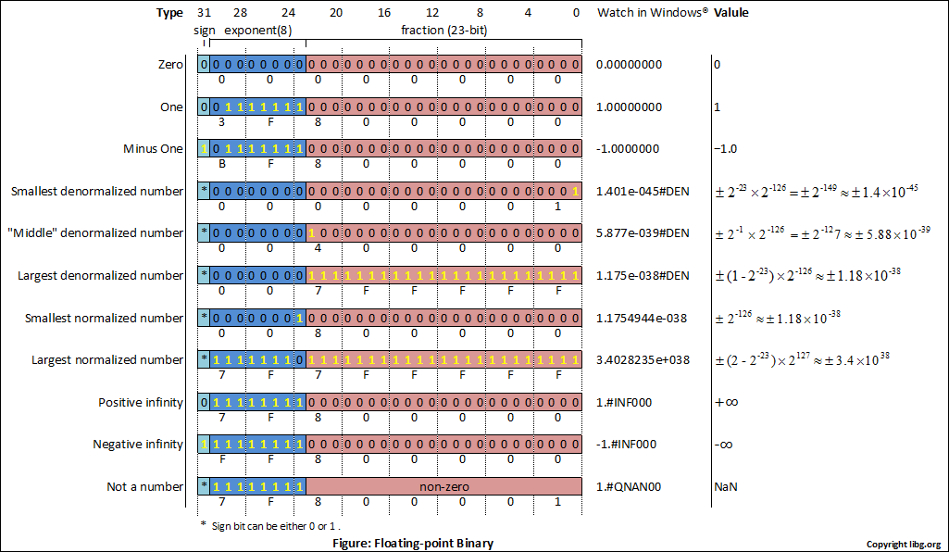

Slide 30
 | Denormalized | Normalized
Single Precision | ± 2⁻¹⁴⁹ to (1−2⁻²³)×2⁻¹²⁶ | ± 2⁻¹²⁶ to (2−2⁻²³)×2¹²⁷
Double Precision | ± 2⁻¹⁰⁷⁴ to (1−2⁻⁵²)×2⁻¹⁰²² | ± 2⁻¹⁰²² to (2−2⁻⁵²)×2¹⁰²³

Slide 31
Summary of Floating Point
Real Number Encodings
−∞
+∞
-Normalized
-Denorm
+Denorm
+Normalized
NaN
−0
+0
NaN

Slide 32
Interesting Numbers
Description exp frac Numeric Value
Zero 00…00 00…00 0.0
Smallest Pos. Denorm. 00…00 00…01 2– ^{{23,52}} X 2– ^{{126,1022}}
  Single ≈ 1.4 X 10^{–45}
  Double ≈ 4.9 X 10^{–324}
Largest Denormalized 00…00 11…11 (1.0 – ε) X 2– ^{{126,1022}}
  Single ≈ 1.18 X 10^{–38}
  Double ≈ 2.2 X 10^{–308}
Smallest Pos. Normalized 00…01 00…00 1.0 X 2– ^{{126,1022}}
  Just larger than largest denormalized
One 01…11 00…00 1.0
Largest Normalized 11…10 11…11 (2.0 – ε) X 2^{{127,1023}}
  Single ≈ 3.4 X 10³⁸
  Double ≈ 1.8 X 10³⁰⁸

Slide 33
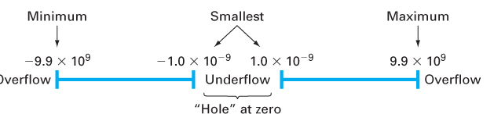
Overflow and Underflow

Slide 34
Underflow
Underflow occurs when a positive result becomes smaller than the smallest representable, positive number; the result is then set to 0. This also happens with negative numbers with small magnitude. In most environments you will get a warning, but otherwise the calculations will continue. This will usually not be a problem, but you should be aware of what happens

Slide 35
Overflow
When the absolute value of a result becomes too large for the floating point standard, overflow occurs. This is indicated by the result receiving the value infinity or possibly positive infinity or negative infinity. There is a special combination of bits in the IEEE standard for these infinity values. When you see infinity appearing in your calculations, you should be aware; the chances are high that the reason is some programming error, or even worse, an error in your algorithm.

